Slide 1
Genuine Ice Cream
MTP2
Trevor Stewart, Alistair Stewart, Kim Scanlon, Ellie Darr

Slide 2
Areas of Focus
Recording and analyzing the time required to produce each flavor of ice cream for recipe adjustments and a price audit
Saving time energy and water by adjusting the temperature of water used to cool the motor of new Ice cream machine

Slide 3
Different Products
Tubs
Main Focus
Pints, Quarts, Minis
Ice Cream Cakes, Ice Cream Sandwich's

Slide 4
Main Variables
Style
Mix-In, Regular
Category
Classics, R1 Mint, R2 Coffee, R3 Peanut Butter, RR Random Rotators
Machine
Old V.S New

Slide 5
Why We Care
Adjusting recipes saves time training and limits waste
E.g., Chocolate Ice Cream
Faster run times means more ice cream can be made in a day increasing potential revenue
Having detailed times of how long it takes to make each flavor to start to finish can help adjust pricing of more time-consuming flavors to better reflect the true cost of pruduction

Slide 6
Methods And Code
How I defined and timed different processes
Run Time
From when the machine is turned on till the tubs are lidded
Turn Over Time
From when the tubs were put away till the machine is turned on again
Clean Time
Time from when water is first added to the machine until the next input is added
Mix Time
Time to mix individual basses if multiple were done at once total time was divided by number of inputs made
Mixing Turnover Time
Time from when the last input was made until ingredients were put away and the table was cleaned
Total Time
Cumulative time off all other variables

Slide 7
Methods And Code
Packages used
Dpylr, Ggplot2, Tidyverse
Main functions used
Group by, Summarise, Ggplot,

Slide 8
Methods And Code

Slide 9
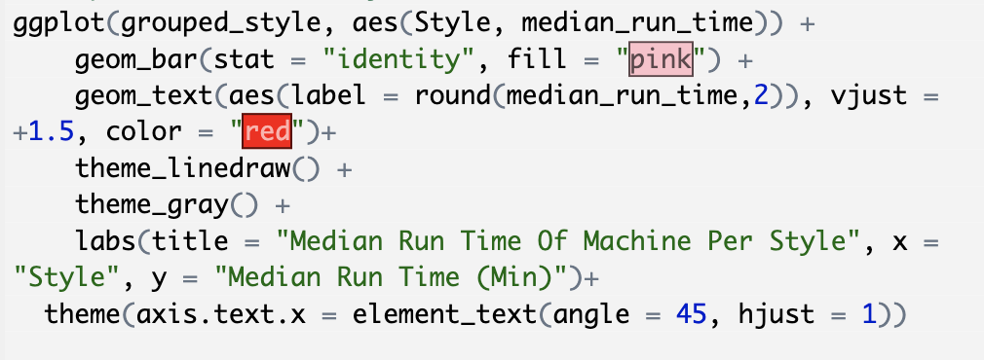
Methods and code

Slide 10
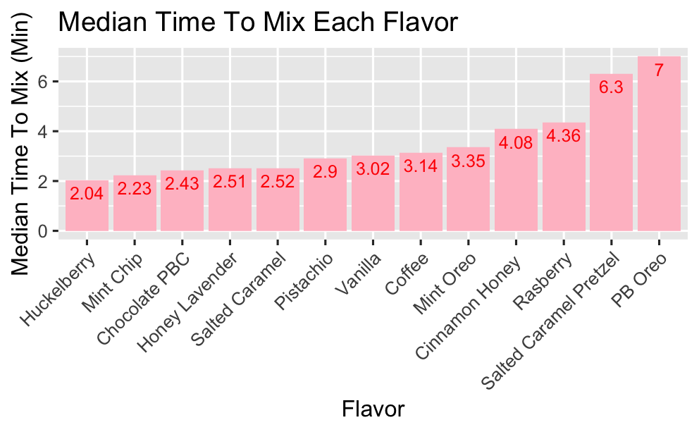
All Data

Slide 11
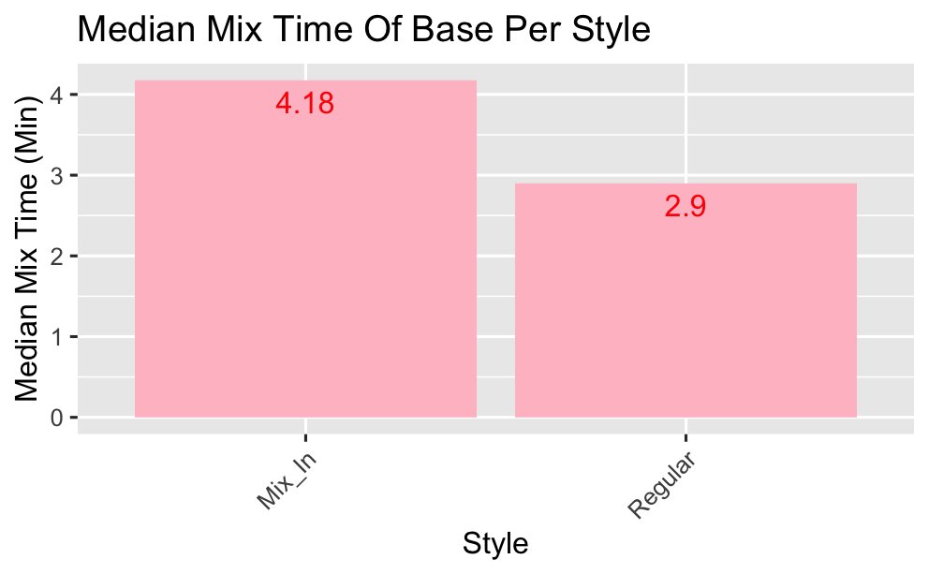
Style

Slide 12
Style

Slide 13
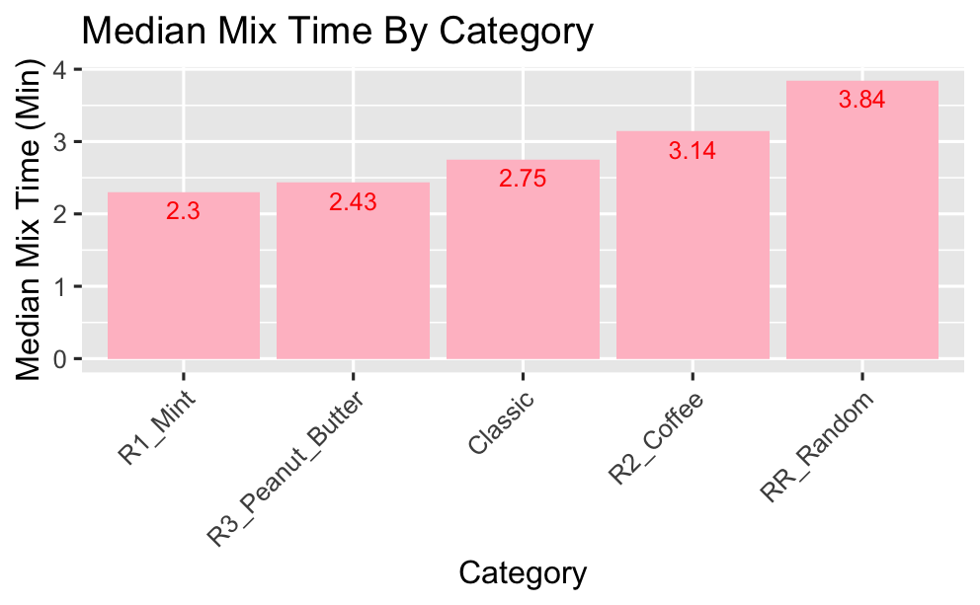
Category

Slide 14
Category

Slide 15
Old V.S New

Slide 16
Adjustments

Slide 17
Old V.S New

Slide 18
Old v.S new
Adjustment saved 1.83 minutes per input
Roughly 11% change

Slide 19
Total Time Saved Estimating 30 Inputs a Day
Day: 54.9 minutes
Week: 274 minutes, 4.6 hours
Month: 1,098 minutes, 18.3 hours
Year: 13,176 minutes, 219 hours

Slide 20
Money saved
Cost ~ $414 to run the factory each day
Over the course of 1 year this adjustment saves ~ $4,000

Slide 21
Small Process Adjustment Suggestions
Fill sinks separately
Load drying rack from the top down
Make chocolate base the day before

Slide 22
Final Deliverable
Spread sheet
Master document with graphs and tables of all flavors and times
Detailed write up of data and findings (Case Study)

Slide 23
Questions?
Thank You

