Slide 1
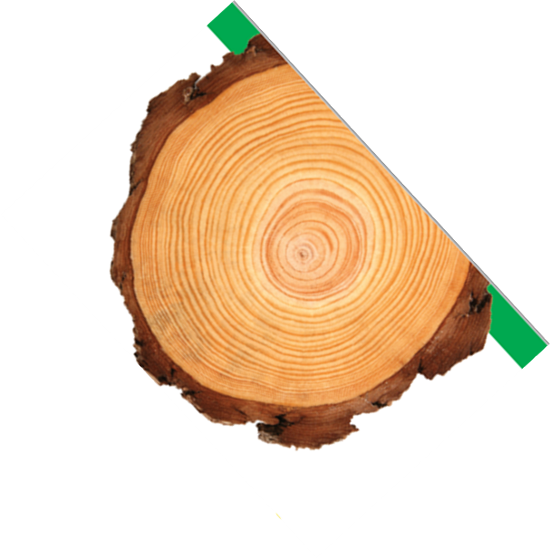
Project Learning Tree
Professional Development Event
Date
Location
Notes:
***Please update date and location for your PD event.

Slide 2
MT PLT Land Acknowledgement
MT PLT and our national sponsor, the Sustainable Forestry Initiative, would like to recognize the fact that this PD event at __(location)__ is occurring on the ancestral territories of the __(tribe)__ people in what is now __(City/County) __, MT. We are committed to building forest-focused collaborations that recognize and respect Indigenous Peoples’ rights, traditional knowledge, diverse ways of knowing, relationships with the land, enduring leadership in forest stewardship, and responsibilities to future generations.
Notes:
Contributors provide financial assistance and supporters don’t contribute directly financially but instead sponsor workshops, provide food and facilitators, etc.

Slide 3
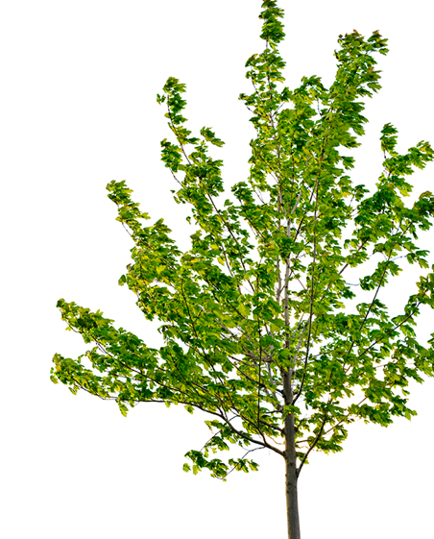
SPEAKER PIC
Speaker Name
Speaker Work Title
SPEAKER PIC
Speaker Name
Speaker Work Title
Notes:
***Please replace pictures and contact information for the PD event facilitators.

Slide 4
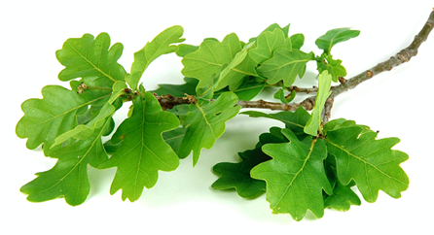
What is Project Learning Tree?
Project Learning Tree is the environmental education program of the Sustainable Forestry Initiative Inc.
Founded in 1973, PLT is an award-winning program designed for educators working with students in pre-K through 12th grade.
Activities are used to supplement the regular curriculum.
PLT TEACHES STUDENTS HOW TO THINK, NOT WHAT TO THINK ABOUT ENVIRONMENTAL ISSUES
Notes:
PLT is the oldest Environmental Education curriculums available. Although the program is the oldest, it is also the most up to date as our curriculum is annually evaluated and updated.
PLT activities are meant to only be a supplement to your regular curriculum, with hands-on activities designed to incorporate the environment into the classroom, using critical thinking and problem solving skills.

Slide 5
Our Goal
Project Learning Tree advances environmental literacy, stewardship, and career pathways using trees and forests as windows on the world.
Notes:
Read goal

Slide 6
Who uses PLT?
Classroom Teachers
Youth Group Leaders
Nature Center Staff
Museums, Zoos, Parks
Day Care Facilities
Resource Professionals
Government Agencies
Parents
Community Groups
Notes:
Anyone who teaches youth can use PLT!

Slide 7
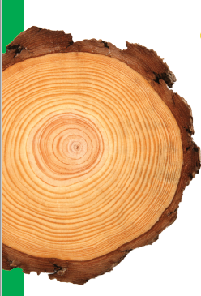
Why should you use PLT materials?
PLT is inexpensive (uses household items)
PLT activities are fun and engaging
PLT WORKS - greater retention, greater involvement, less disciplinary problems & better attitudes
PLT is multi-disciplinary - teaching skills in Science, Math, Language Arts, Social Studies, Visual and Performing Arts
PLT is correlated to State & National Standards
Notes:
Self explanatory

Slide 8
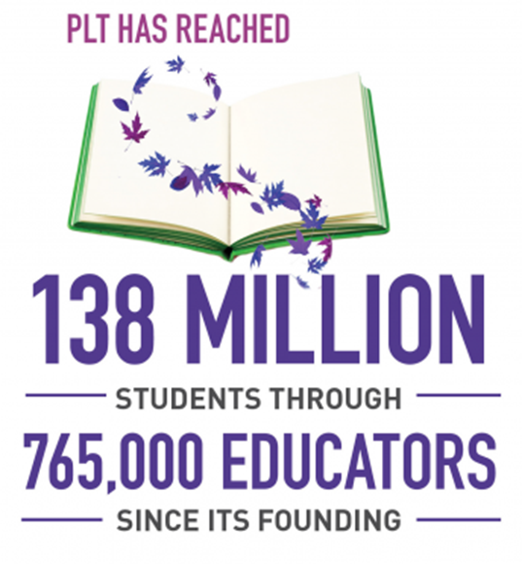
Where is PLT?
EVERYWHERE! (Almost)
All 50 states plus DC
Brazil
Canada
Chile
Japan
Mexico
Puerto Rico
Uruguay
Notes:
We have a long record of quality professional development trainings, reaching over 17,000 educators since the State Department of Education brought PLT to South Carolina in 1980.

Slide 9
PLT 45 Years of History
47 Years of History
1976 PLT began in 13 Western states
1980 PLT went International with Canada becoming a partner
1980 PLT brought to S.C. by the State Dept. of Education
1984 SC PLT begins operating as a non-profit consortium
1989 PLT reaches 49 states
1993 PLT releases its new revised PreK-8 Activity Guide and Greenworks! service learning grant program
1994 National Field Study of PLT by the Research Commission of the NAAEE
1995 First Secondary Modules released
2002 PLT releases Energy & Society
2006 PLT releases newly revised PreK-8 Activity Guide
2010 PLT releases Environmental Experiences for Early Childhood
2014 PLT in partnership with PINEMAP release Southeastern Forests and Climate Change
2015 PLT offers the first online workshops!
2017 PLT introduces online E-Units & SFI becomes the national sponsor
2018 PLT creates Teaching with i-Tree in partnership with U.S. Forest Service
2020 PLT releases Green Jobs guide
2021 PLT releases newly revised K-8 guide
2022 PLT releases newly revised Early Childhood guide
2023 PLT releases The Journeys of Black Professionals in Green Careers guide
Notes:
Bold statements are important - Do not need to cover everything
PLT has been constantly updated and improved, adding additional quality curriculum to high school and special topics in the environment.

Slide 10
National Partners
PLT has a wide range of national partnering organizations, some of which include:
Notes:
The national sponsors show the diversity of the environmental community that supports the PLT program.

Slide 11
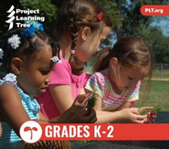
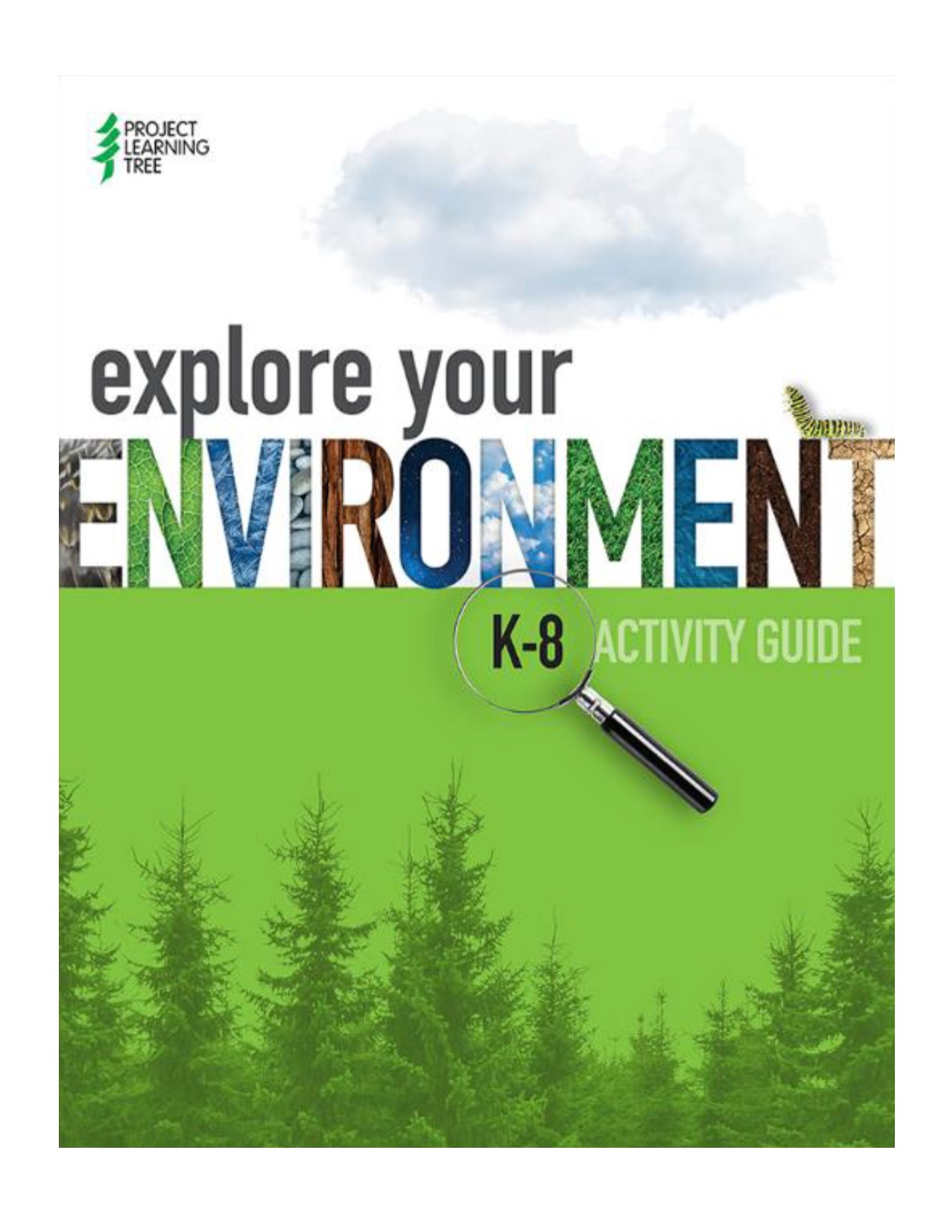
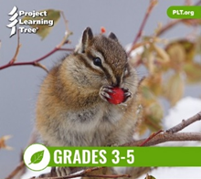
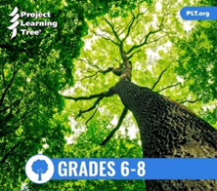
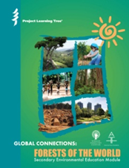
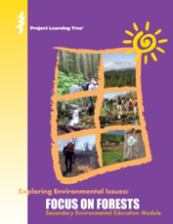
What does PLT provide for educators?
Trees & Me (early childhood)
Explore Your Environment K-8
E-Units
K-2 Treemendous Science
3-5 Energy in Ecosystems
6-8 Carbon & Climate
Secondary modules
Focus on Forests
Forest of the World
Green Jobs
Teaching with i-Tree
Southeastern Forests and Climate Change
Journeys
Notes:
Trees & Me (new Early Childhood guide) and Explore Your Environment K-8 are new re-editions that have lots of great new changes and additions.
E-Units are self-contained units of instruction that are fully online, making it easy for teachers to access and use.
PLT has a whole line of secondary modules for middle and high school programs.

Slide 12
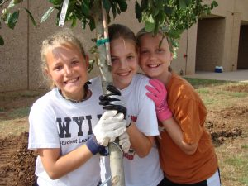
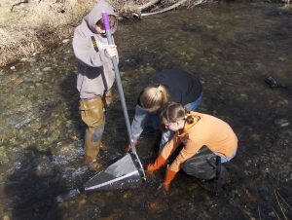
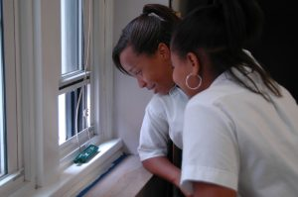
PLT GreenSchools! Investigations
PLT’s GreenSchools! program inspires students to apply their STEM and investigative skills to create greener and healthier schools – and save schools money.
School Site
Energy
Waste & Recycling
Water
Environmental Quality
Available online (FREE) and in print at www.plt.org
Notes:
Engage students in STEM as they investigate their school site, energy use, water, waste and recycling practices. Five investigations empower students to make their schools green and healthy.

Slide 13
National PLT Resources
Correlations to state, national, and informal education curriculum standards at: www.plt.org/alignment-to-standards
Additional resources for PLT’s activities
The BRANCH e-newsletter
FREE Activities for Families
STEM Strategies
www.plt.org
Notes:
This is a good time to show National PLT’s website or at least mention it.
Please show the following online resources:
-How to set up a PLT account
-How to find upcoming open to the public trainings
-Correlations to national and state standards
-Resources for the PLT activity guide you are leading a training in
-Free Family and Friends activities

Slide 14
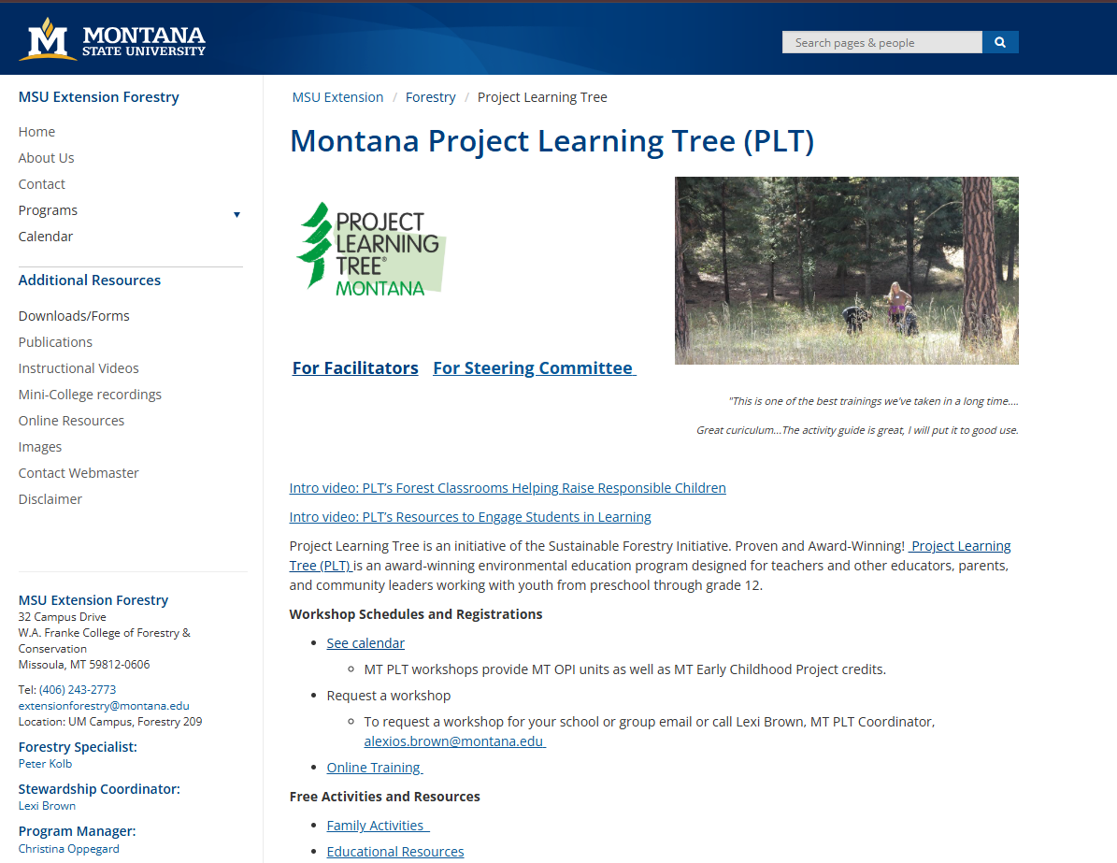
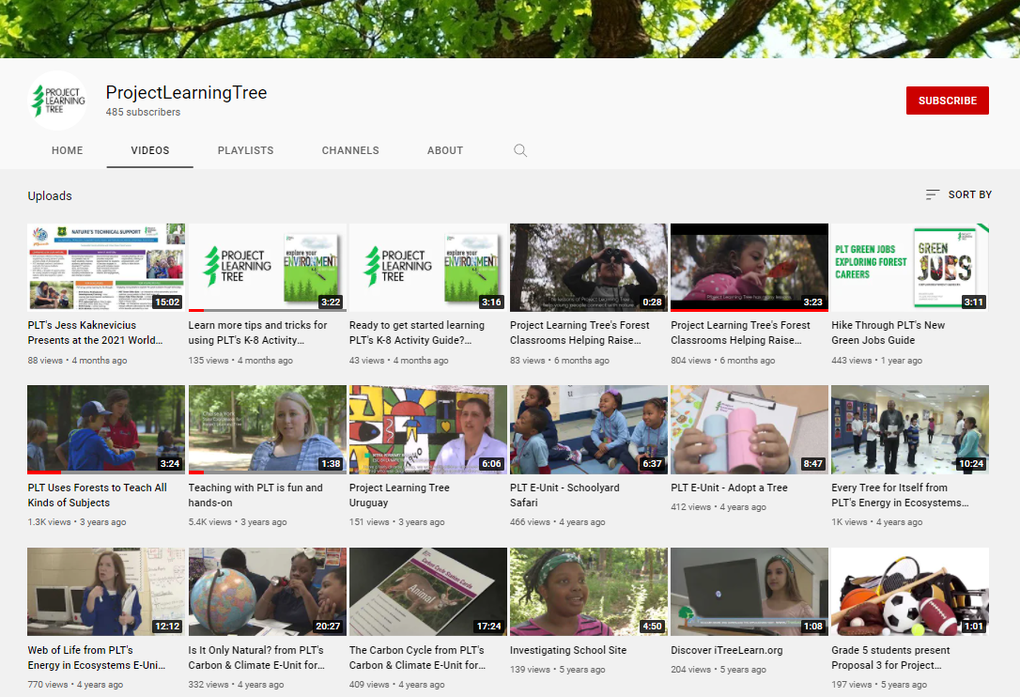
Also Available Online
MT PLT Website:
https://www.montana.edu/extension/forestry/projectlearningtree/index.html
Video demonstrations of activities: www.youtube.com/user/ProjectLearningTree/videos
Notes:
This is a good time to show National PLT’s website and our SC website.
Please show the following online resources:
-How to set up a PLT account
-How to find upcoming open to the public trainings
-Correlations to national and state standards
-Resources for the PLT activity guide you are leading a training in
-Free Family and Friends activities

Slide 15
Our Vision
Project Learning Tree’s vision is a world that values and benefits from sustainably managed forests.
TEACHING STUDENTS HOW TO THINK, NOT WHAT TO THINK ABOUT ENVIRONMENTAL ISSUES
Notes:
Read vision and ask for any questions

